Slide 1
Toy joy shelling
Rathod Harshita & Mehta Mansi

Slide 2
kamani science & prataprai Arts college, Amreli
Guide by
MR. Prakash Gajera
Developed By
Harshita Rathod ( 6110 )
Mehta Mansi ( 6112 )

Slide 3
Introduction
In this website we display normally all type of toys. So people can use that site and get information what they want.
Our website online toys shopping is used to purchase toys and view toy’s information.
In this site if user have purchase any toy then first register and then they can purchase items.
It provides the basic information about toy.

Slide 4
Strategies[ SDLC ]
The proposed CMS will go through the following stages of development in its software development life cycle. Here as seen “waterfall” model of development is adopted
planning
Design
implementation
testing
analysis
maintenance
Toy joy

Slide 5
Analysis
A toy is an item that is used in play, especially one designed for such use.
Different materials like wood card, paper, and plastic are user to make toys. Many item are designed to serve as toys, but goods produced for other proposed can also be used.
For instance , a small l child may fold an ordinary piece of paper into an Airplane shape and “fly it”

Slide 6
REQUIREMENT ANALYSIS
Our project title is online toy shelling. Our project is providing games and child toys Relate website. Requirements analysis is done in order to understand
The problem the software system is to solve.
The goal of the requirements activity is to document the requirements
In a software requirements specification document.
There are two major activities in this phase: Problem Understanding
Or Analysis and Requirement Specification. In problem analysis, the aim is understand the problem and its context, and the requirements of the new system that is to be developed.

Slide 7
CURRENT SYSTEM
When website related concept was not out come in market, peoples are used too many websites like flipkart and amazon other material for getting play.
While you are reading any materials or books at that time if you get some Questions or confusion, there you need to meet someone else to sold out your debuts so this processes time consuming.
PROPOSED SYSTEM
To provide an interactive and user-friendly website to the user.
To provide a high-performance system that works much faster.
To provide a simple and consistent output, which meets user’s requirements.
To provide a simple as well as economical system.

Slide 8
ABOUT FRONT-END
Asp.net
ASP.NET is the next generation of ASP, but it’s not an upgraded version Of ASP. ASP.NET is an entirely new technology for sever side scripting. ASP.NET is a part of the Microsoft .NET framework, and a powerful tool for creating Dynamic and interactive web pages.
ASP.NET is a web application framework development marked by Microsoft To allow programmers to build dynamic web site, web application and Web services.
It was first released in January 2002 with version 1.0 of the .NET, framework, and it is success to Microsoft’s active sever page (ASP) technology. ASP.NET is built on the common language runtime (CLR), allowing programmer to write ASP.NET code using any supported. .NET language.

Slide 9
ABOUT BACK-END
Sql server
SQL server is powerful multi-user DBMS. It can be used to store and manipulate large amount of information and automate repetitive tasks, such as marinating an inventory and generating invoices by using data input forms can be easily developed. Data can be processed and created meaningful reports.
Data in SQL Server organized in form of table. Within a table records are arranged accordingly to a common reference value known as primary key. The value in the key fields is different for every record and thus helps in uniquely identifying records.
A combination of two or more fields can be used as a primary key. Such a combination is called a composite key. Since a value in one table can be replicated across other table there should be a way to maintain a relationship is implemented through the concept of foreign key. A foreign key in a table is field, which links that table to another table; in the SQL Server we can retrieve the data from two tables in one table through join query

Slide 10
Software & Hardware requirement
Software Requirement Hardware Requirement
Frontend tool Processor i3 processor
ASP.NET R.A.M. 2GB
Backend tool Hard-disk space 500GB
Sql server
Other software
Visual studio 2008
Windows 10

Slide 11
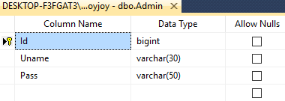
Data Dictionary
Admin

Slide 12
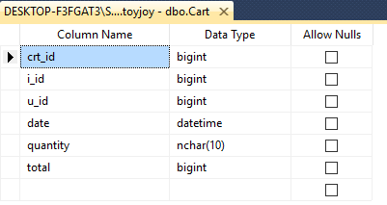
Cart

Slide 13
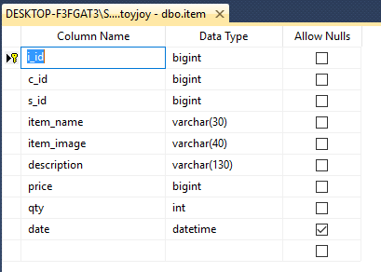
Item

Slide 14
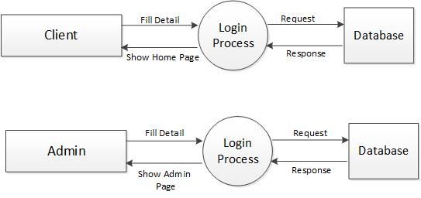
Data flow Diagram (0) level

Slide 15
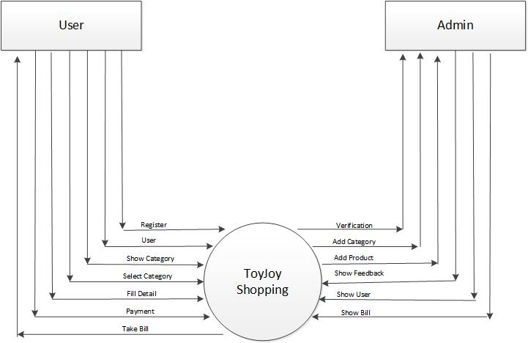
(0) level dfd

Slide 16
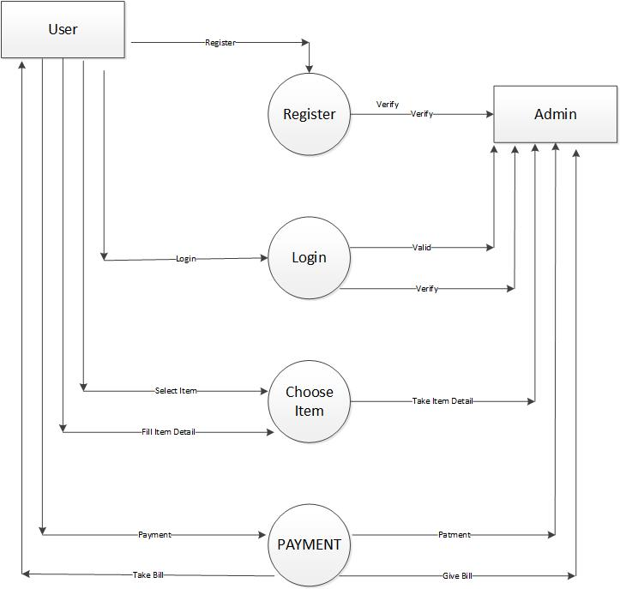
Firstlevel dfd(1)

Slide 17
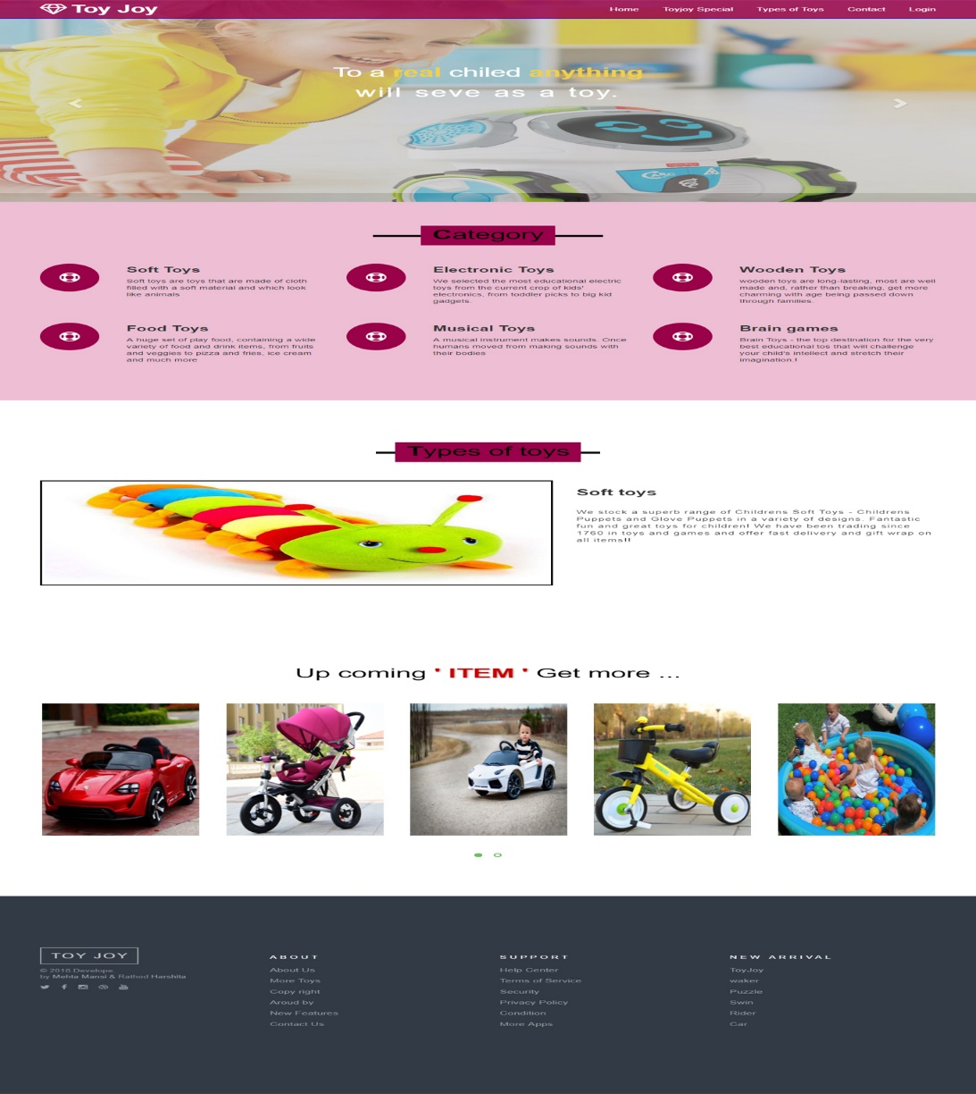
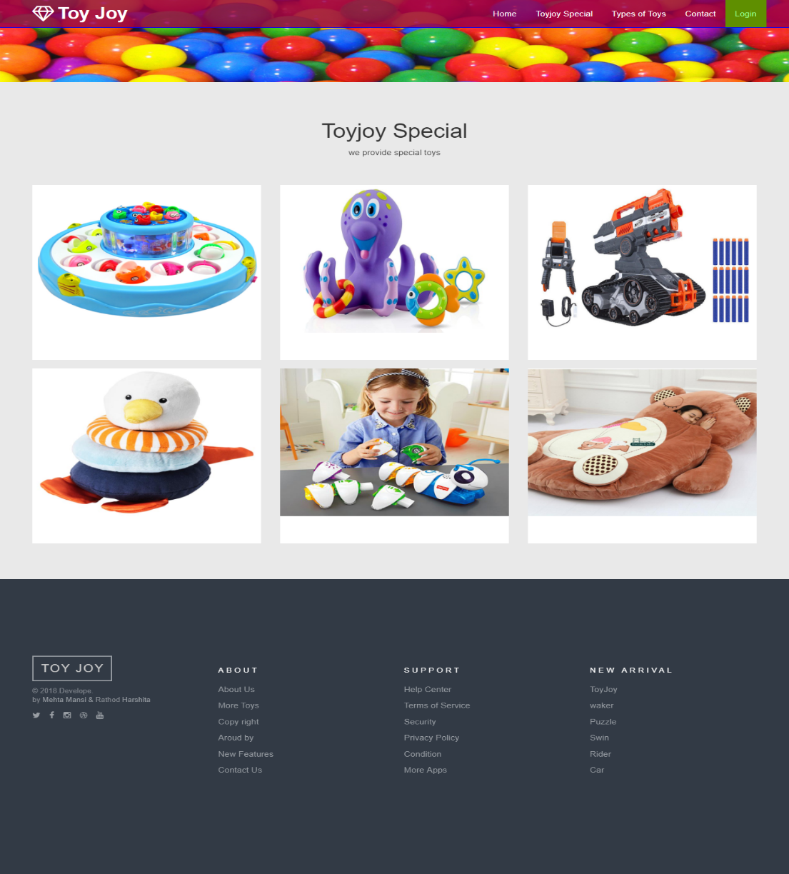
Screen layout

Slide 18
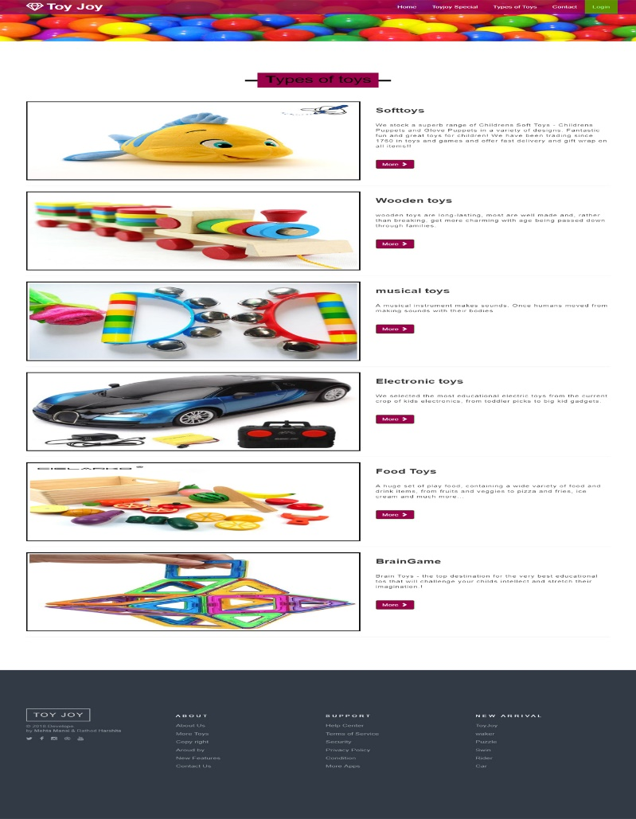
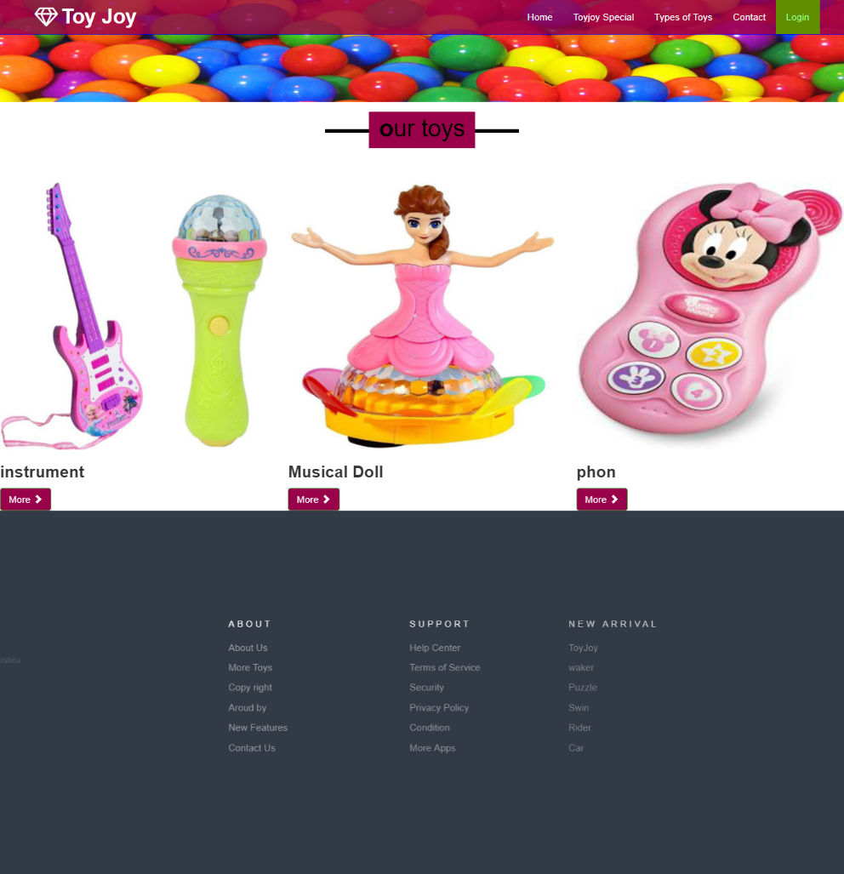
Screen layout

Slide 19
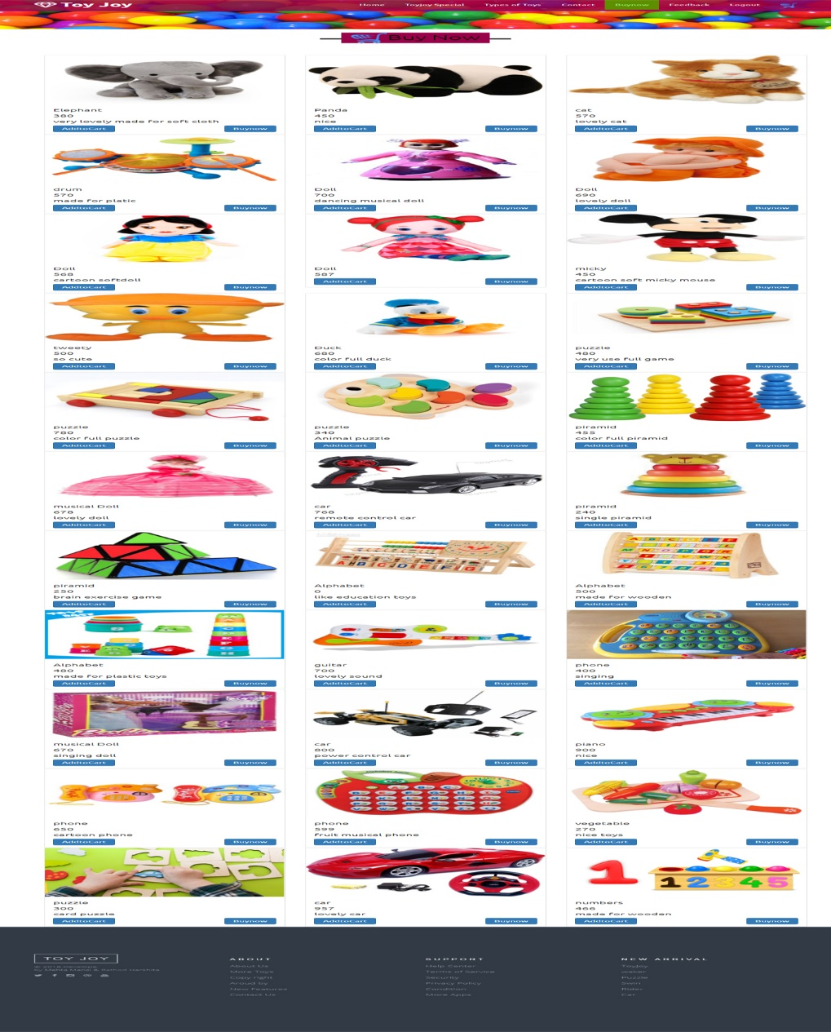
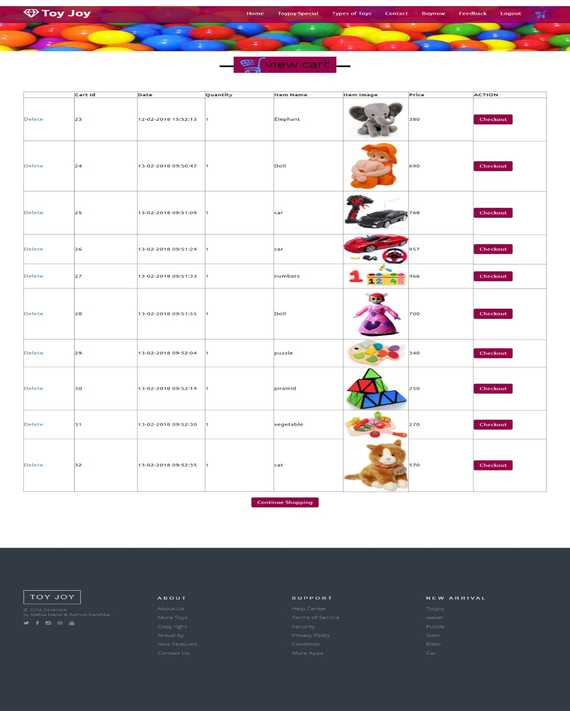
Screen layout

Slide 20
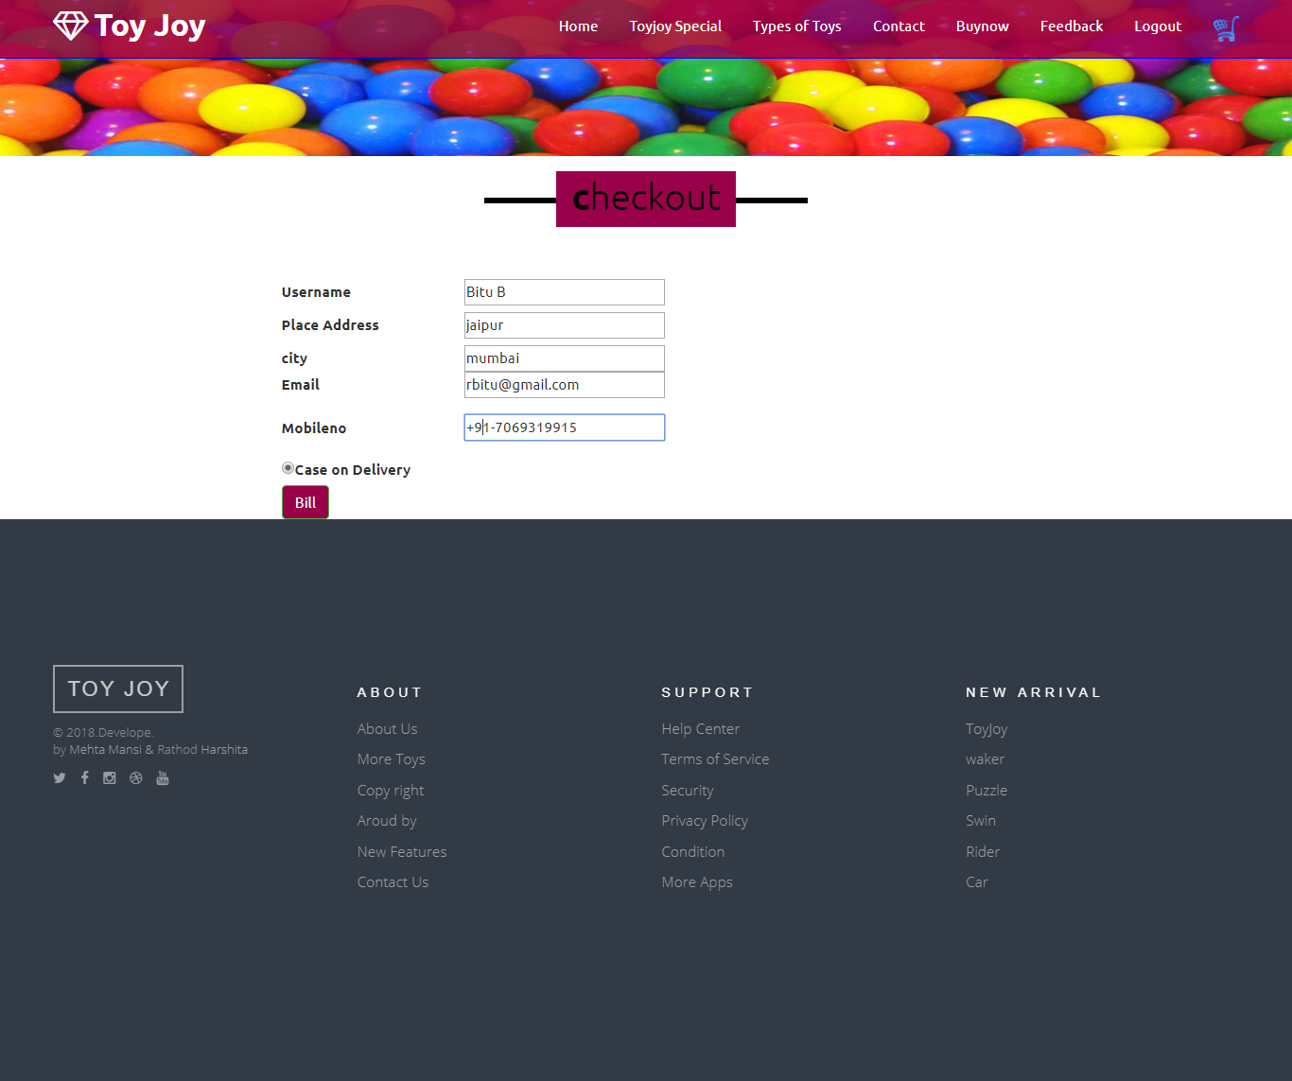
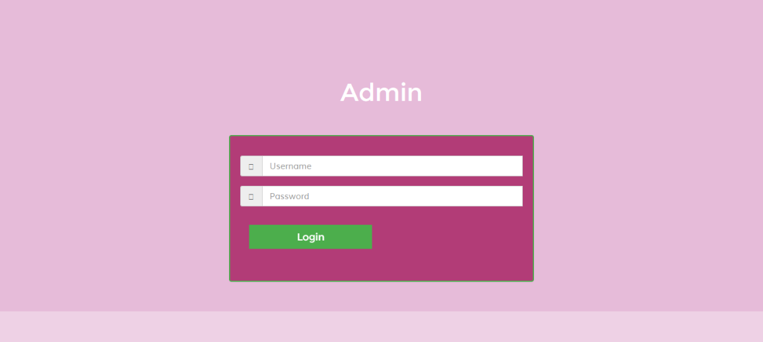
Screen layout

Slide 21
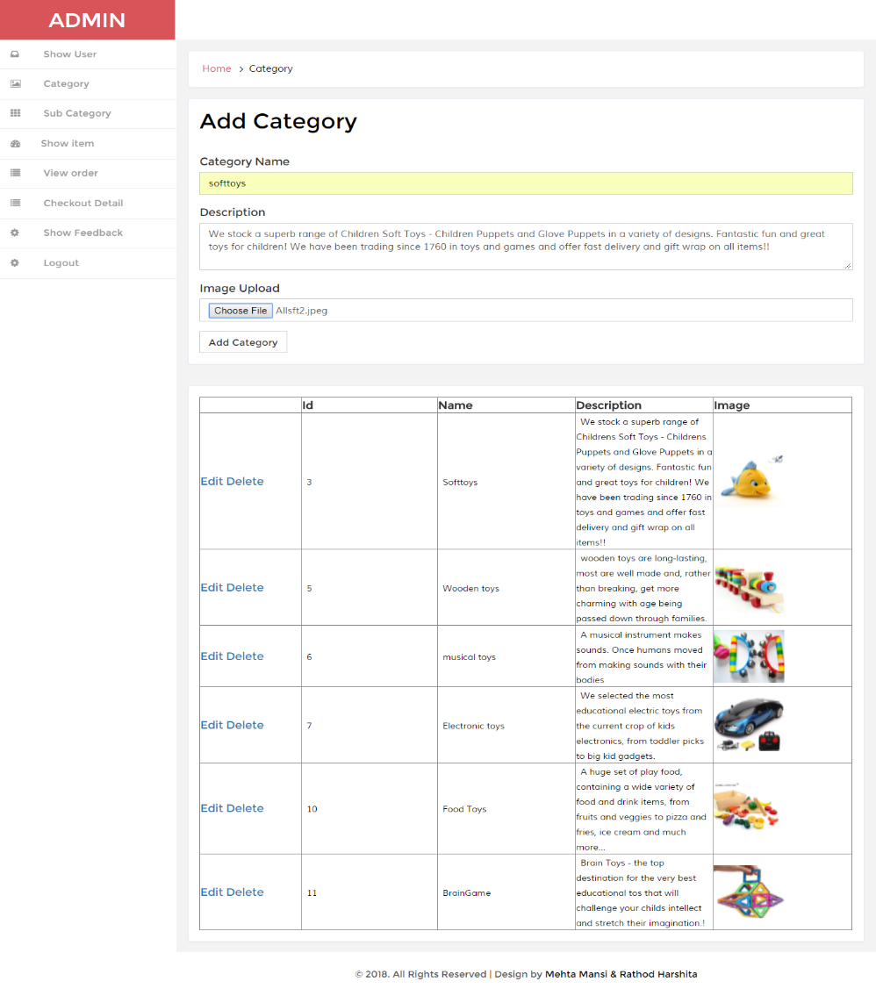
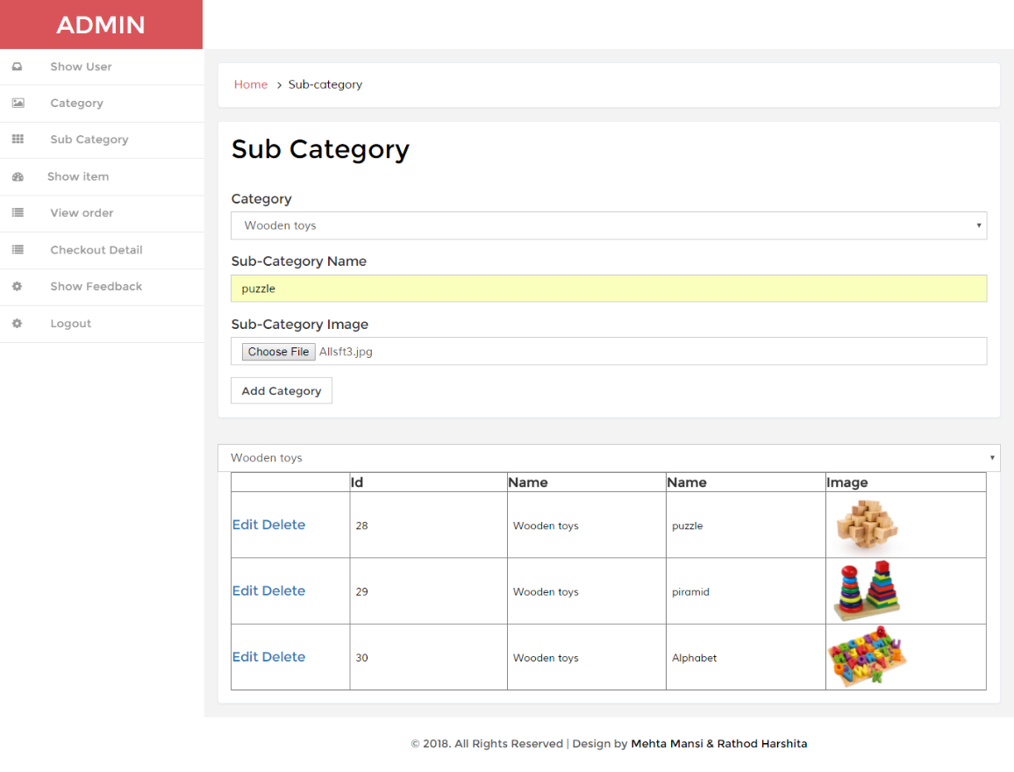
Screen layout

Slide 22
Testing plan
The main purpose of testing is to find the error and bugs.
To ensure that during operation the system will perform as per specification.
To make sure that the system meets user’s requirements during operation.
To see that the when correct inputs are fed to the system, then the outputs are correct.
Test the system using the wrong input and check the it will give an error or not.

Slide 23
Limitation
If user forgot the password than we can not recover it.
If there is any problem in network it will not get proper data.

Slide 24


